Slide 1
Safety Driving Recognition
Federico Cavedoni
Francesco Bruno

Slide 2
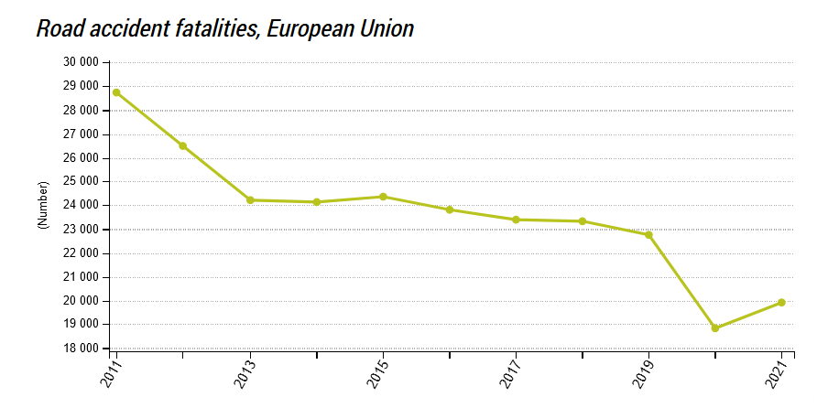
Safety Driving Recognition
https://ec.europa.eu/eurostat/web/products-eurostat-news/w/ddn-20230620-1

Slide 3
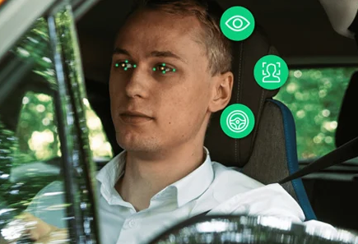
Safety Driver Conditions MONITORING
Our Goal is trying to reduce the number of accidents by analysing:
Driver distraction
Driver drowsiness
Driver medical conditions.

Slide 4
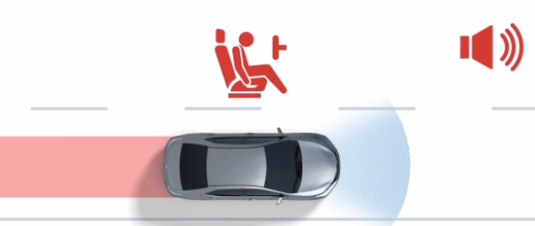

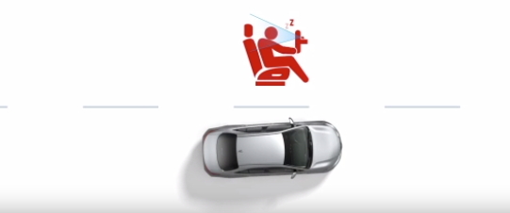
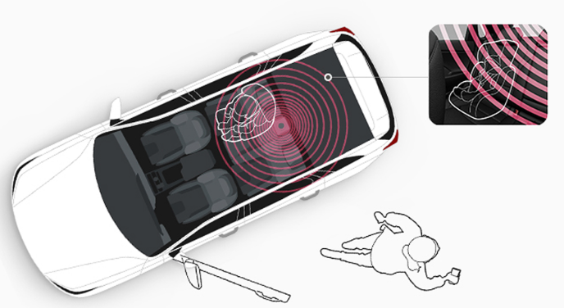
State of the Art (1/4)
T-Mate by Toyota
Emergency Detection Stop System
Driver Monitor Camera
Rear Passenger Detection
https://www.toyota.it/mondo-toyota/sicurezza

Slide 5


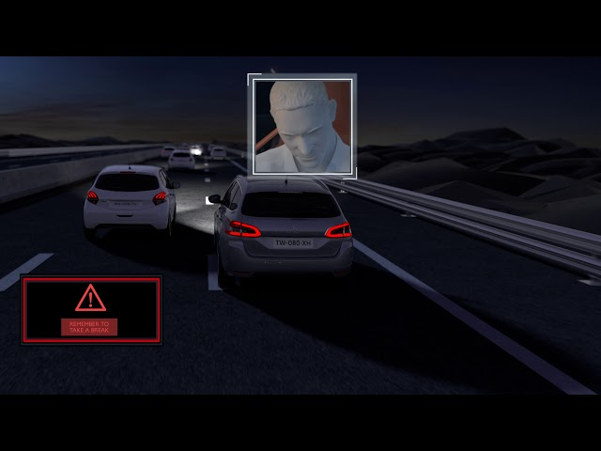
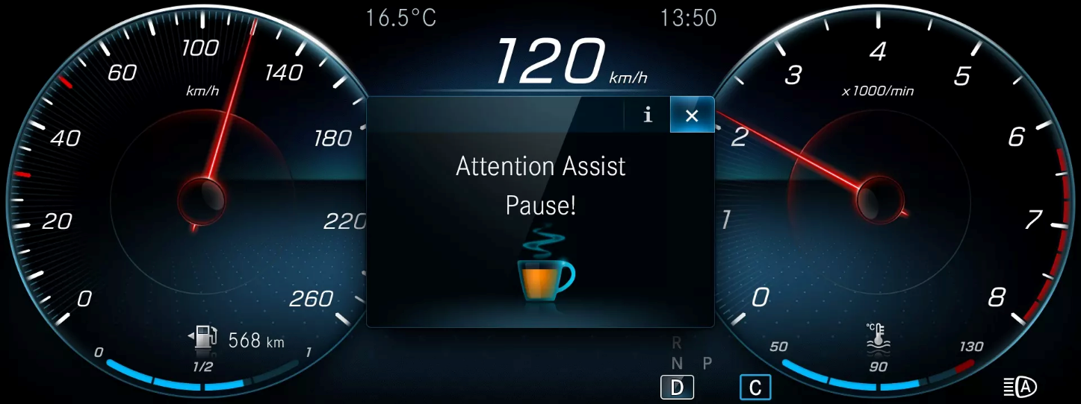
State of the Art (2/4)
ATTENTION-ASSIST by MERCEDES-BEN
DRIVE ASSIST by PEUGEOT

Slide 6
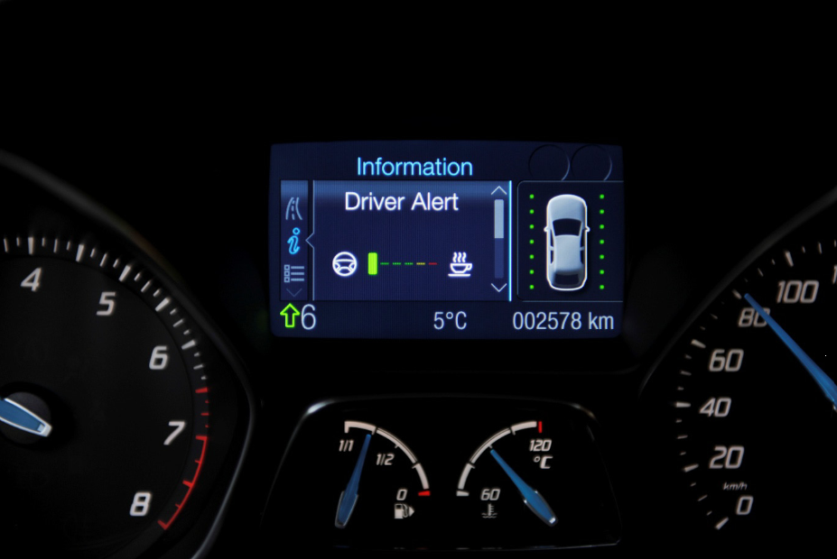
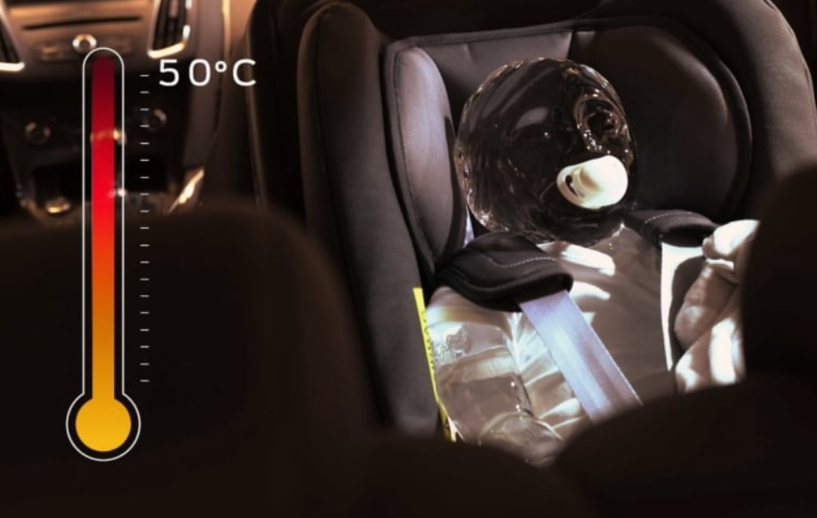

State of the Art (3/4)
DRIVER ALERT by FORD

Slide 7



State of the Art (4/4)
Design of Smart Steering Wheel for Unobtrusive Health and Drowsiness Monitoring https://www.mdpi.com/1424-8220/21/16/5285
Driver Vital Signs Monitoring Using Millimeter Wave Radio https://ieeexplore.ieee.org/abstract/document/9615374?casa_token=M6LXft8mKGAAAAAA:6q_D-AZFErSj8-zDADY9Jr3E5jsF9uk2_-fL5LMsdKS0VvmRgMZl1-khlwde__6VOq2k_gxUew
Driver Distraction Detection on Edge Devices via Explainable Artificial Intelligence (UNIPI) https://www.iiis.org/DOI2023/SA300MJ/

Slide 8






Market Analysis
 | Vital Signal Monitoring | Rear Passenger Detection System | Driver Distraction Detection
T-MATE
ATTENTION ASSIST
DRIVER ALERT
DRIVE ASSIST

Slide 9
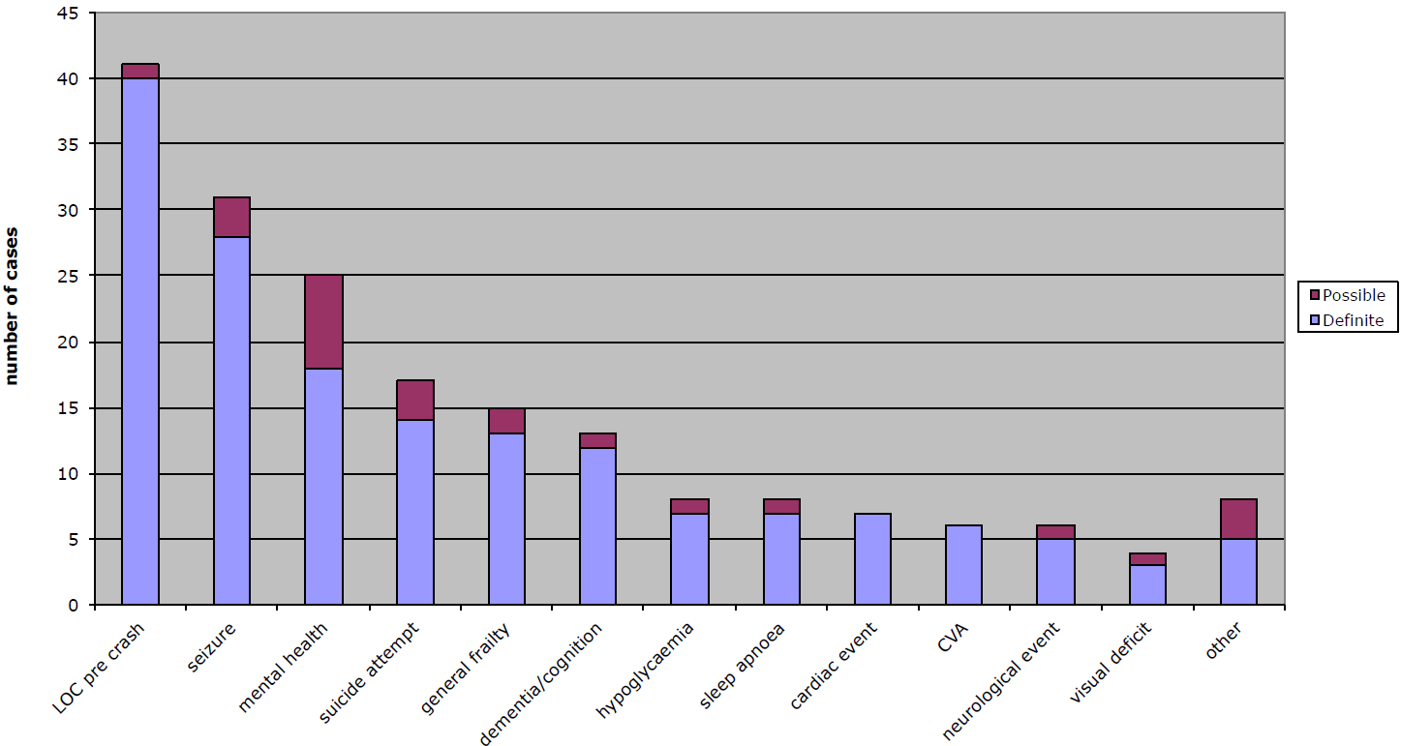
Health-related car accident causes
https://www.google.com/url?sa=t&rct=j&q=&esrc=s&source=web&cd=&ved=2ahUKEwjT8sfNxeuCAxUdSfEDHcBeD2AQFnoECBkQAQ&url=https%3A%2F%2Fcasr.adelaide.edu.au%2Fcasrpubfile%2F1151%2FCASRmedicalconditionscrashcausation-1253.pdf&usg=AOvVaw1w0m53NVsb3qGhGR1NHdpB&opi=89978449

Slide 10
Technologies analysis
 | Syncope | Seizure | Hypoglicaemia | Drowsiness | Hearth Attack | Stroke
PPG
ECG
IR CAMERA
RADAR

Slide 11

USER SPECIFICATIONS
The system must be not invasive
The system must be user-adaptable
The system periodically get data from sensors
The system classifies the obtained data
The system takes decisions based on classified data

Slide 12
PRODUCT SPECIFICATIONS
The sampling process must not distract the driver
The vital parameters must be specific for each user https://www.ncbi.nlm.nih.gov/pmc/articles/PMC6147850/
The classification must have an high precison (80%) https://www.mdpi.com/2073-431X/10/12/158

Slide 13
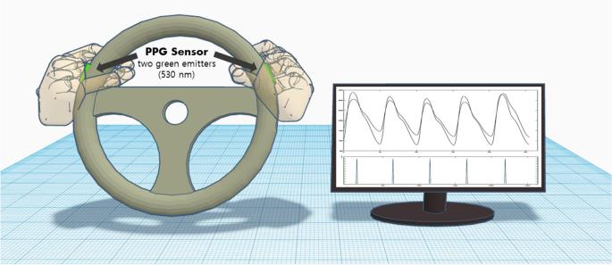
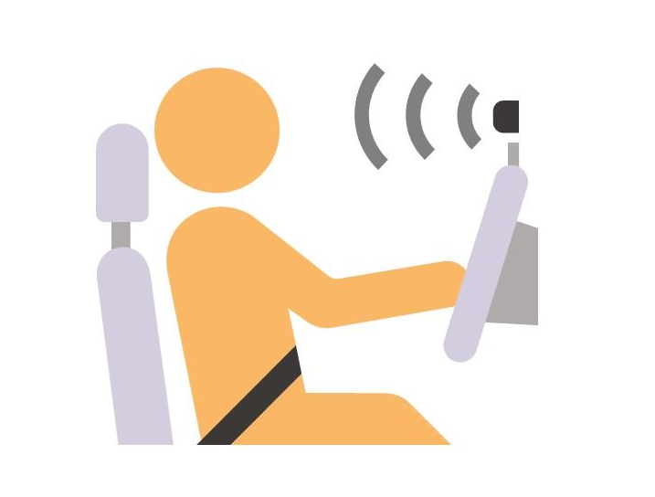
ENABLING TECHNOLOGIES (1/2)
Periodic data collected by PPG sensor
Data classified with LSTM Neural Network https://ieeexplore.ieee.org/document/9573888
The classification parameters are user-specific

Slide 14

ENABLING TECHNOLOGIES (2/2)
PPG Sensor:
Less invasive respect to ECG
Used to obtain Hearth Rate Variability (HRV)
LSTM Neural Network:
Better performance during testing
No pretrained solutions
https://ieeexplore.ieee.org/stamp/stamp.jsp?tp=&arnumber=9807511

Slide 15
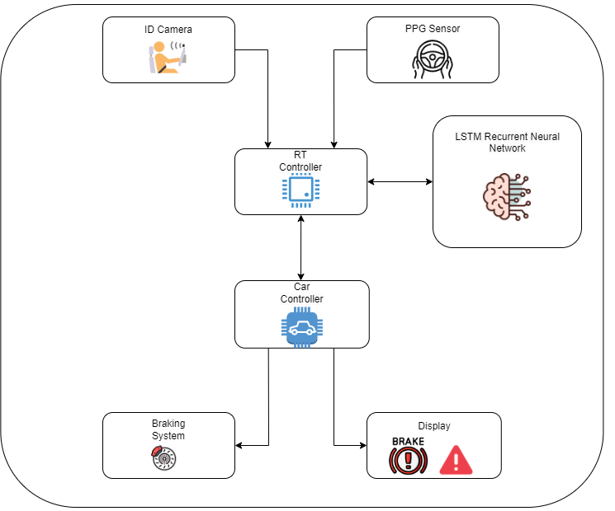
PRODUCT ARCHITECTURE

Slide 16
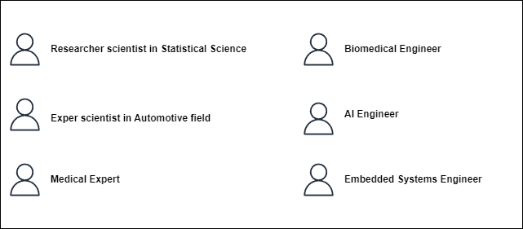
PROFILE ANALYSIS

Slide 17
WORK PACKAGE 1 (1/4)
WP 1 | WP Title: Analysis of factors that increase driving danger WP Type: R.I. | Activity Start: Month 1 | Activity End: Month 2
Man/Month: 0.3 + 0.6 + 0.3 + 0.3 = 1.8 Man/Month
Objectives: Identification of the main causes of accidents Understand what technologies exist to improve driving safety Understand what are the most frequent causes related to driver health problems Understand what technologies can detect the most frequent health problems that lead to accidents

Slide 18
WORK PACKAGE 1 (2/4)
Activities: Analysis of the most common accidents causes Market analysis Analysis of actual used technologies (State of Art study) Analysis of accident rates caused by sickness Study of key monitoring technologies on driver status

Slide 19
WORK PACKAGE 1 (3/4)
Roles hours per Task: Analysis of the most common accidents causes (Month 1) Researcher scientist of Statistical Science. Approx: 50 hours (0,3 man/month) Market analysis (Month 1) Expert scientist in Automotive field. Approx: 100 hours (0,6 man/month) Analysis of accident rates caused by sickness (Month 2) Researcher scientist of Statistical Science. Approx: 50 hours (0,3 man/month) Study of key monitoring technologies on driver status (Month 2) Medical Expert. Approx: 50 hours (0,3 man/month) Embedded Systems Engineer. Approx: 50 hours (0,3 man/month)

Slide 20
WORK PACKAGE 1 (4/4)
Costs: Researcher scientist of Statistical Science. Approx: 100 hours (0,6 man/month) €20 per hour x 50 hours = €1.000 €20 per hour x 50 hours = €1.000 Expert scientist in Automotive field. Approx: 100 hours (0,6 man/month) €20 per hour x 100 hours = €2.000 Medical Expert. Approx: 50 hours (0,3 man/month) €30 per hour x 50 hours = €1.500 Embedded Systems Engineer. Approx: 50 hours (0,3 man/month) €40 per hour x 50 hours = €2.000 Total Cost: €7.500

Slide 21
WORK PACKAGE 2 (1/4)
WP 2 | WP Title: Preliminary product analysis WP Type: R.I. | Activity Start: Month 3 | Activity End: Month 5
Man/Month: 0.6 + 0.6 + 0.6 + 0.6 + 0.6 = 3.0 Man/Month
Objectives: Choice of vital signs to be monitored Deriving User Specifications Deriving Product Specifications Derive the enabling technologies for the product

Slide 22
WORK PACKAGE 2 (2/4)
Activities: Analysis of the car application market and derivation of user specifications Development of product specifications Vital sign detection study Analysis of user specifications and derivation of product specifications Analysis of product specifications and derivation of required enabling technologies Analysis of enabling technologies and derivation of the best for the use case

Slide 23
WORK PACKAGE 2 (3/4)
Roles hours per Task: Analysis of the car application market and derivation of user specifications. (Month 3) Expert scientist in Automotive field. Approx: 100 hours (0.6 man/month) Development of product specifications (Month 3-4) Medical Expert. Approx: 100 hours (0.6 man/month) Embedded Systems Engineer. Approx: 100 hours (0.6 man/month) Analysis of enabling technologies and derivation of the best for the use case (Month 4-5) Researcher scientist in AI. Approx: 100 hours (0.6 man/month) Researcher scientis in Embedded systems. Approx: 100 hours (0.6 man/month)

Slide 24
WORK PACKAGE 2 (4/4)
Costs: Researcher scientist in Automotive field. Approx: 100 hours (0.6 man/month) €20 per hour x 100 hours = €2.000 Medical Expert. Approx: 100 hours (0.6 man/month) €20 per hour x 100 hours = €2.000 Embedded Systems Engineer. Approx: 100 hours (0.6 man/month) €40 per hour x 100 hours = €4.000 Researcher scientist in AI. Approx: 100 hours (0.6 man/month) €20 per hour x 100 hours = €2.000 Researcher scientist in Embedded systems. Approx: 100 hours (0.6 man/month) €20 per hour x 100 hours = €2.000 Total Cost: €12.000

Slide 25
WORK PACKAGE 3 (1/4)
WP 3 | WP Title: Development of product architecture WP Type: R.I. | Activity Start: Month 6 | Activity End: Month 8
Man/Month: 0.25 + 0.25 + 0.25 + 0.6 + 0.3 + 0.3 + 0.25 + 0.25 + 0.25 = 2.7 Man/Month
Objectives: Product architecture development Identify specific Neural Network Identify Sensor Type

Slide 26
WORK PACKAGE 3 (2/4)
Activities: Initial product architecture design Analysis and identification of the best neural network Analysis and identification of the best sensors for the use case Final product architecture design

Slide 27
WORK PACKAGE 3 (3/4)
Roles hours per Task: Initial product architecture design (Month 6) Embedded Systems Engineer. Approx: 40 hours (0.25 man/month) AI Engineer. Approx: 40 hours (0.25 man/month) Biomedical Engineer. Approx: 40 hours (0.25 man/month) Analysis and identification of the best neural network (Month 6-7) AI Engineer. Approx: 100 hours (0.6 man/month) Analysis and identification of the best sensors for the use case (Month 7-8) Embedded Systems Engineer. Approx: 50 hours (0.3 man/month) Biomedical Engineer. Approx: 50 hours (0.3 man/month) Final product architecture design (Month 8) Embedded Systems Engineer. Approx: 40 hours (0.25 man/month) AI Engineer. Approx: 40 hours (0.25 man/month) Biomedical Engineer. Approx: 40 hours (0.25 man/month)

Slide 28
WORK PACKAGE 3 (4/4)
Costs: Embedded Systems Engineer. Approx: 120 hours (0.75 man/month) €40 per hour x 40 hours = €1.600 €40 per hour x 50 hours = €2.000 €40 per hour x 40 hours = €1.600 AI Engineer. Approx: 120 hours (0.75 man/month) €40 per hour x 40 hours = €1.600 €40 per hour x 100 hours = €4.000 €40 per hour x 40 hours = €1.600 Biomedical Engineer. Approx: 80 hours (0.5 man/month) €40 per hour x 40 hours = €1.600 €40 per hour x 50 hours = €2.000 €40 per hour x 40 hours = €1.600 Total Cost: €17.600

Slide 29
WORK PACKAGE 4 (1/4)
WP 3 | WP Title: Product development WP Type: S.S. | Activity Start: Month 9 | Activity End: Month 12
Man/Month: 0.6 + 0.9 + 0.9 + 0.9 = 3.3 Man/Month
Objectives: Neural network development Embedded software development Prototype development and testing

Slide 30
WORK PACKAGE 4 (2/4)
Activities: Development of the neural network that classifies the data collected by the sensor Development and Training of the network Testing and evaluation of the network Development of embedded software Development of the controller firmware Development of the sensor driver Driver testing Development of the prototype Testing and evaluation of the prototype

Slide 31
WORK PACKAGE 4 (3/4)
Roles hours per Task: Development of the neural network that classifies the data collected by the sensor (Month 9) AI Engineer. Approx: 100 hours (0.6 man/month) Development of embedded software (Month 9-10) Embedded Systems engineer. Approx: 150 hours (0.9 man/month) Development of the prototype (Month 11-12) AI Engineer. Approx: 150 hours (0.9 man/month) Embedded Systems engineer. Approx: 150 hours (0.9 man/month)

Slide 32
WORK PACKAGE 4 (4/4)
Costs: AI Engineer. Approx: 250 hours (1.5 man/month) €40 per hour x 100 hours = €4.000 €40 per hour x 150 hours = €6.000 Embedded Systems Engineer. Approx: 300 hours (1.8 man/month) €40 per hour x 150 hours = €6000 €40 per hour x 150 hours = €6000 Total Cost: €22.000

Slide 33
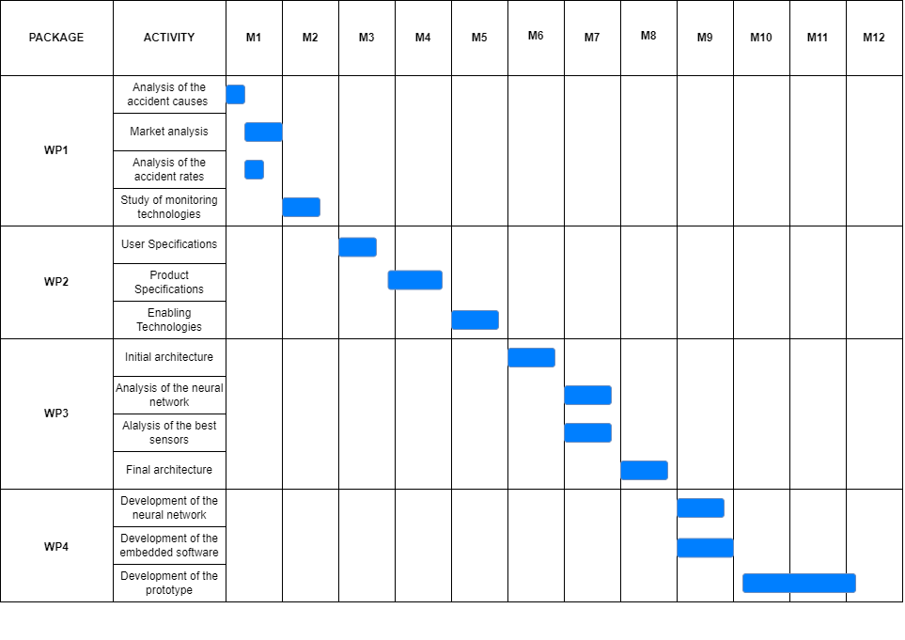
GAANT CHART

Slide 34

RISK ANALYSIS (1/2)
INTERNAL RISKS:
Errors and Delays during project development
Errors and possible delays can result in increased project costs.
Delays were minimized by trying to allocate a congruous number of hours for each task.
Errors are minimized by using the AGILE methodology, which allows efficient error correction due to its multiple iterations.
Enabling Technologies not found
If the chosen enabling technologies cannot be found, it will be sufficient to replace them with similar technologies due to the modularity of the system.
For example, in the absence of suitable ppg sensors we could choose another sensor from which can be extracted hearth rate variability (HVR).

Slide 35
RISK ANALYSIS (2/2)
EXTERNAL RISKS:
PPG Sensor
The data collected is used to extract the Herath rate variability (HRV), which can be extracted from many other types of sensors.
Therefore, if the PPG sensor fails in the market, it would not be a problem, since another sensor would be fine to extract this feature.
LSTM Neural Network
We chose the LSTM neural network because it is currently the best solution in long time-series classifications.
If, in the future, a better solution will be discovered, the network can be replaced, since the system depends on the classification and not on the type of network chosen.

Slide 36
rEFERENCES (1/2)
Syncope via PPG and ECG: https://pubmed.ncbi.nlm.nih.gov/25769176/
Seizure via PPG and ECG: https://www.mdpi.com/1424-8220/21/18/6017
Hypoglycemia via PPG: https://www.ncbi.nlm.nih.gov/pmc/articles/PMC10057625/
Hearth attack via PPG: https://www.ncbi.nlm.nih.gov/pmc/articles/PMC9371833/
Stroke via PPG and ECG: https://ieeexplore.ieee.org/document/9761215
Hypoglicemia via ECG: https://journals.sagepub.com/doi/10.1177/19322968221116393
Heart attack via ECG: https://www.ncbi.nlm.nih.gov/pmc/articles/PMC6632021/
Seizure from IR Camera: https://www.seizsafe.com/en/

Slide 37
rEFERENCES (2/2)
Man/Month info: 160 (40 hours per week-full time job)
Cost Researcher: https://www.unipi.it/index.php/phoca-prova/category/84-docenti-tabelle-retributive?download=6462:2022-costo-annuo-lordo-personale-dei-professori-e-ricercatori-universitari-secondo-il-nuovo-regime-art-3-comma-2-e-6-del-d-p-r-15-12-2011-n-232-adeguamento-stipendiale-aumento-0-45-dpcm-25-luglio-2022
Cost Embedded Systems Engingeer: https://www.upwork.com/hire/embedded-systems-engineers/cost/
Cost Medical Expert: https://www.becomeopedia.com/medical-researcher/

Slide 38
Thanks for the attention
Federico Cavedoni
Francesco Bruno

